Slide 1
Assignment
Joint NFT Data Analyst Intern
Submitted on : 12/01/2022

Slide 2
Problem Statement
Data comparing different NFT collections; define different metrics to analyze and compare and 80 collection. Share a dashboard or report of the same
Data comparing NFP traders : Show insight into people who can buy and sell NFT is profitably and different metric around their performance

Slide 3
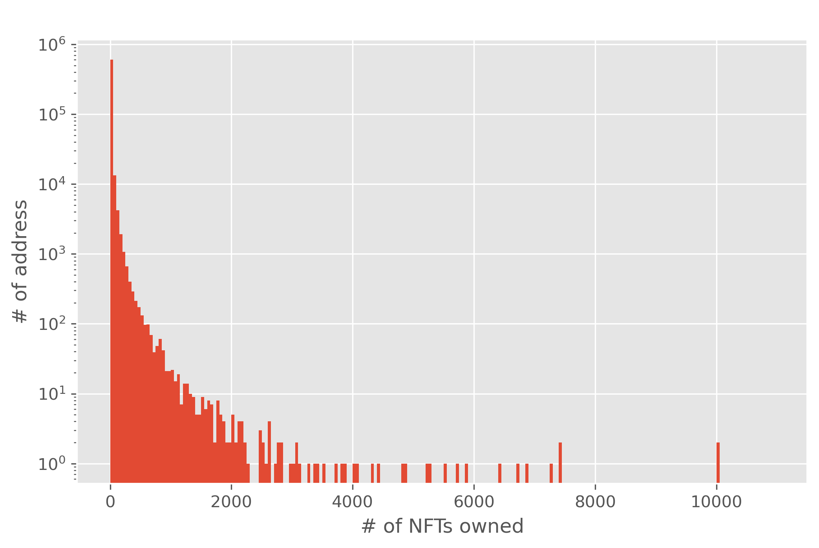
Top 20 owners holding nfts

Slide 4
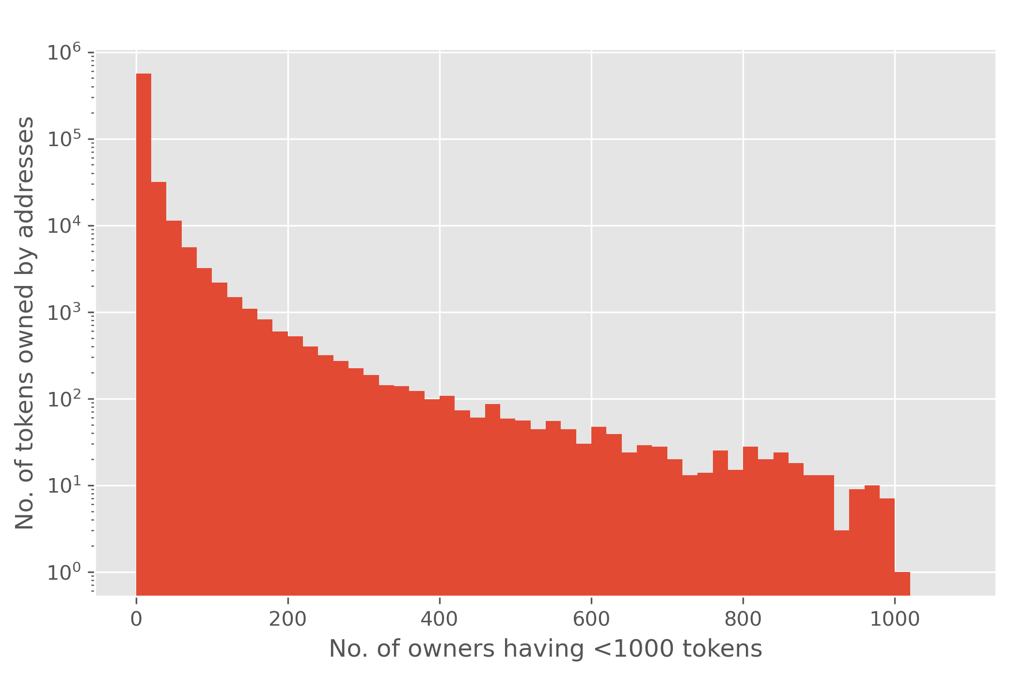
Inferences
We chose a threshold count of 1000 tokens.
A stunning number of NFT owners own only a very small number of tokens. There are only a few address that own hundreds or thousand of tokens.
We hypothesize - any address which owns thousands of tokens is either purchasing those tokens automatically or is financing the collection in which they own tokens

Slide 5
The analysis shows that the decentralized NFT market is indeed decentralized.
There are few addresses which deal in industrial scale implying that the market is owned dealt majorly by the discreet individuals.
There are near to zero large scale NFT owners on Ethereum blockchains.

Slide 6
Caveat
It must be noted that this is an analysis of addressees, not real world entities. It is possible for a single person or organization to use a distinct idiom address to control each NFT their own. This would indicate a mafia of sort.
It also be noted that this would be difficult to operate because if only a handful of players are involved, it is very apparent and could yield to a further network analysis of beer the funds for each NFT purchase we are coming from.

Slide 7
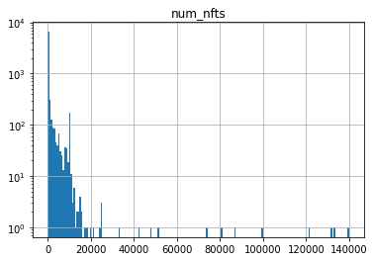
Mints per contract
Most NFTs mint to a relatively small number of receivers
Further by this analysis, relatively few NFTs mint to a single receiver

Slide 8
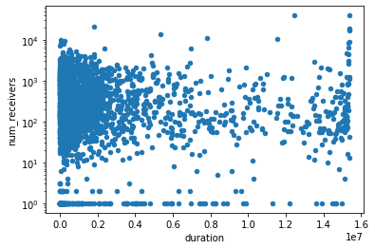
Minting Period
Most NFTs mints their complete supply very soon after launch ( within a day)

Slide 9
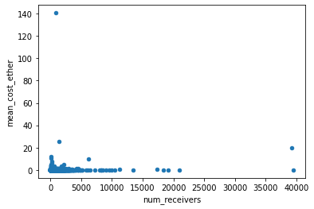
Minting Cost
Most Ethereum NFTs charge ETH for minting.
They maintain a list of addresses that an allowed to mint their tokens and each mint operation is carried out by a member of that list in exchange of a ETH

Slide 10

Thank you!
Pankaj K
+91 7635005202
pankajks@iitk.ac.in
Linked // @ pankajkkss

